Slide 1

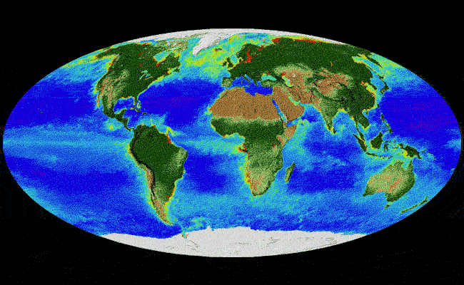
Department of Geography
A.B.M. COLLEGE
Jamshedpur

Slide 2

VISION
- Achieving a pioneer role in the field of Geography and Geographic Information Systems.
- Making citizen to know global changes and its effects on the society
- Being distinctive amongst the other departments on the national, regional, and global levels.

Slide 3
MISSION
- Establishing a system of moral values and the commitment towards development of scientific temper and encouraging creative thinking
- Introducing selected programs that help the students to fulfill his/ her academic and personal ambitions

Slide 4
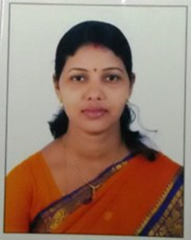
FACULTY
Name of the Teacher - SUCHITA KUMARI
Qualification - M.A , B.Ed. , NET
Pursuing Ph.D
Date of Joining - 09/05/2018
Seminar/Workshop - International – 1
National – 1
Workshop – 1
Other – 1
Publication - 1
Email - suchi.kumari123@yahoomail.com
Mobile No - 9835951590

Slide 5
TEACHING METHOD
The department organizes several activities as follows :-
Lecture Method
Tutorial Classes
Field Work
Educational Tour
Projects
Class Test
Local Survey – Physical & Human
Guest Lecture

Slide 6
ADMISSION IN U.G.(SOCIAL GROUPWISE)
SESSION | ST | SC | OBC | General | TOTAL
2013-16 | 7 | 1 | 1 | 9 | 18
2014-17 | 6 | 1 | 1 | 17 | 25
2015-18 | 7 | 2 | 3 | 31 | 43
2016-19 | 5 | 2 | 6 | 16 | 29
2017-20 | 9 | 1 | 3 | 21 | 34

Slide 7
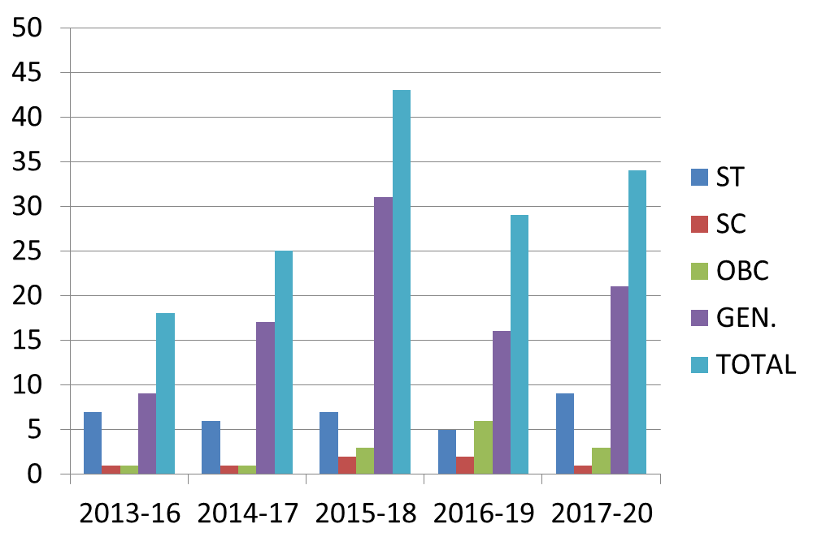

Slide 8

SESSION | BOYS | GIRLS | TOTAL
2013-16 | 9 | 9 | 18
2014-17 | 15 | 10 | 25
2015-18 | 29 | 14 | 43
2016-19 | 9 | 20 | 29
2017-20 | 11 | 23 | 34

Slide 10
RESULT IN U.G.
SESSION | U.G. PART- 1 |  |  | U.G. PART- 2 |  |  | U.G. PART- 3
 | APPEARED | PASS | FAIL | APPEARED | PASS | FAIL | APPEARED | PASS | FAIL
2010-13 | 19 | 12 | 7 | 11 | 10 | 1 | 11 | 11 | 0
2011-14 | 20 | 9 | 11 | 12 | 9 | 3 | 7 | 7 | 0
2012-15 | 30 | 7 | 23 | 12 | 10 | 2 | 10 | 10 | 0
2013-16 | 41 | 22 | 19 | 8 | 8 | 0 | 10 | 8 | 2
2014-17 | 34 | 23 | 11 | 22 | 10 | 12 | 10 | 8 | 2

Slide 11
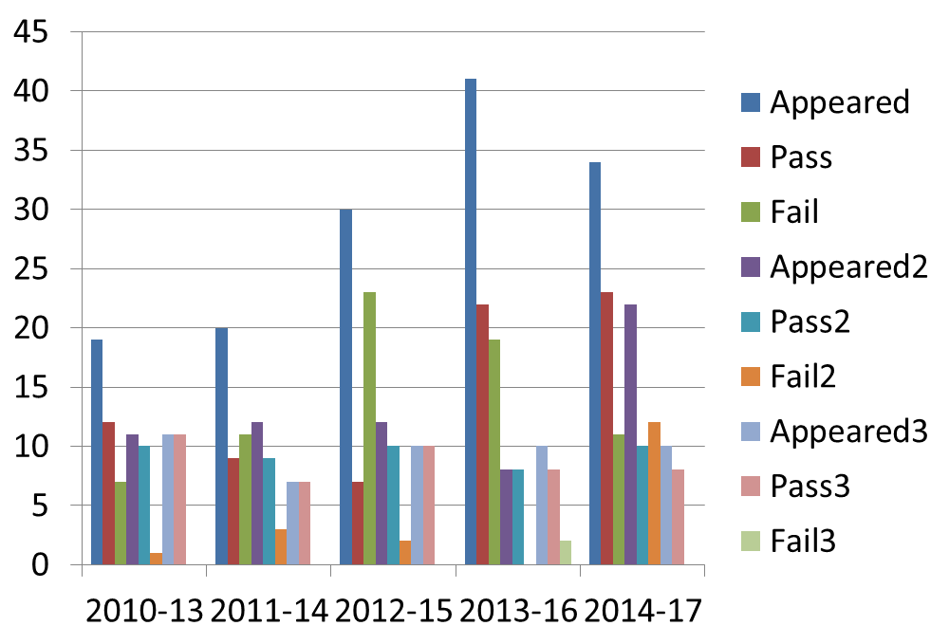

Slide 12
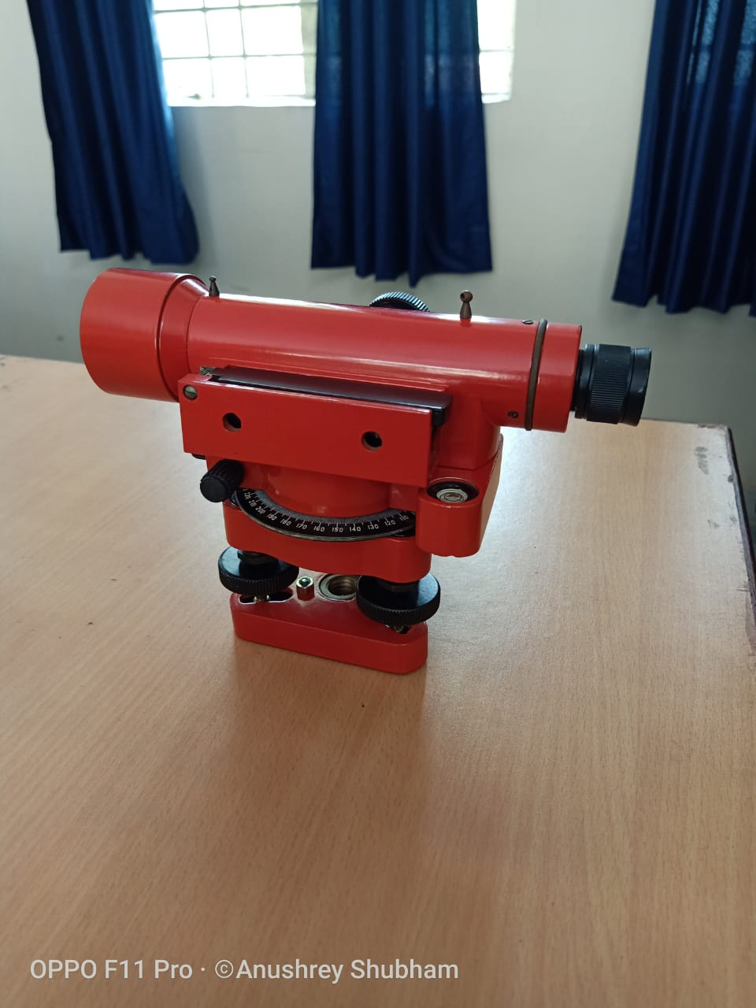
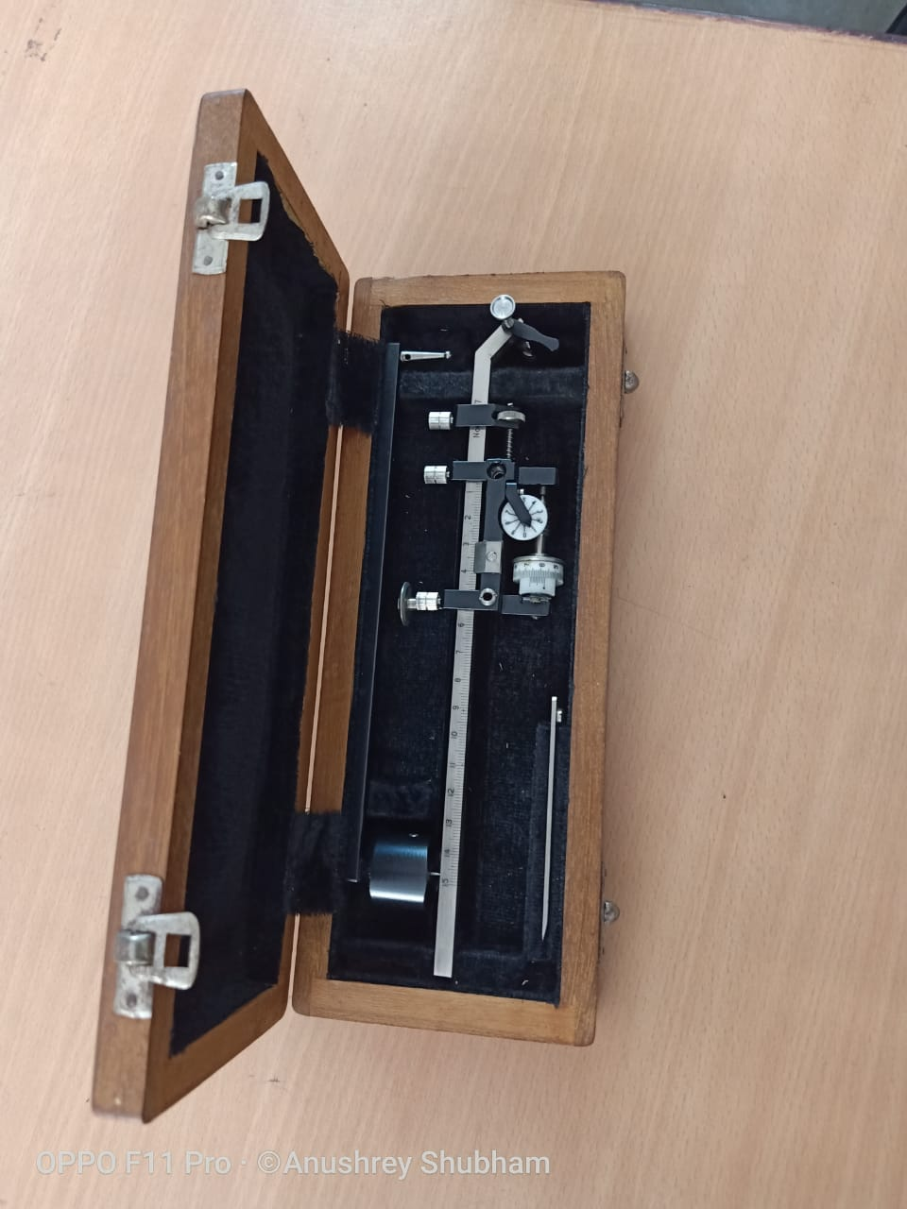
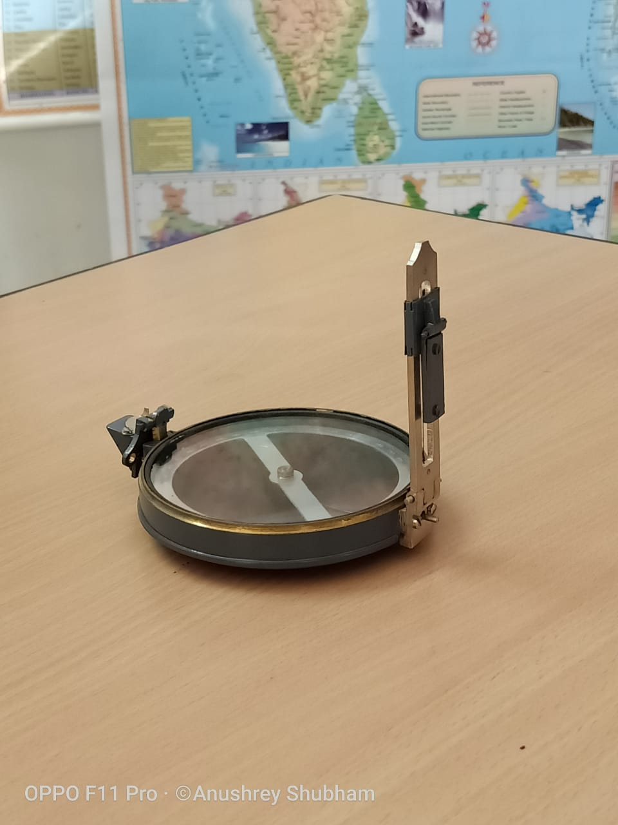
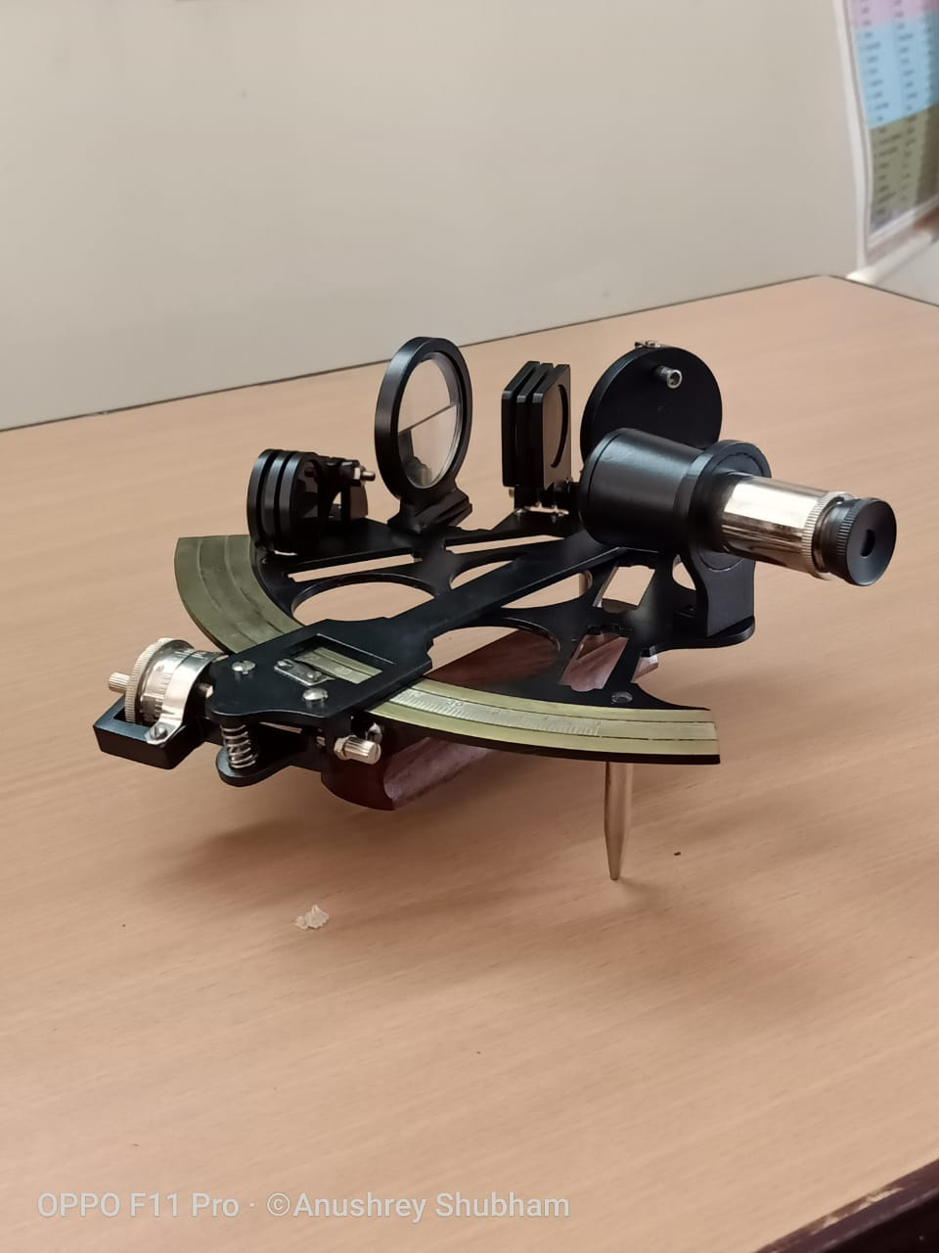
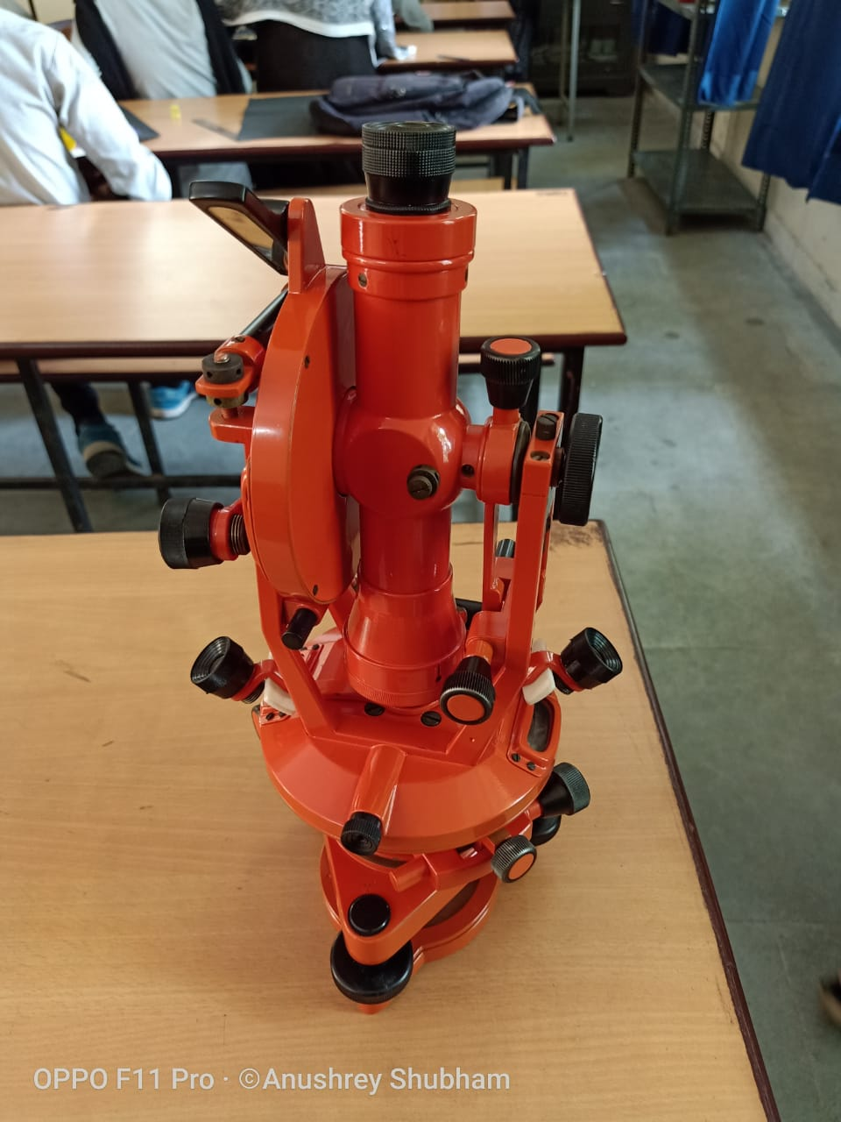
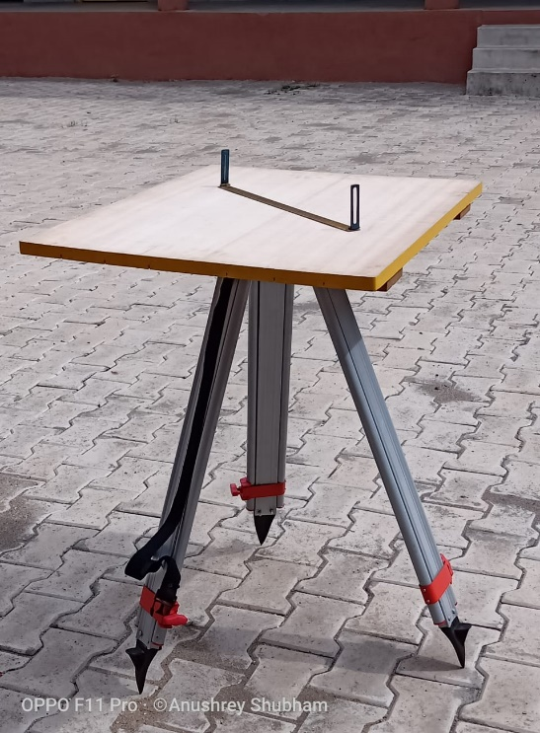
GEOGRAPHICAL EQUIPMENTS
Dumpy Level
Polar Compensating Planimeter
Prismatic Compass
Sextant
Theodolite
Plane Table

Slide 13

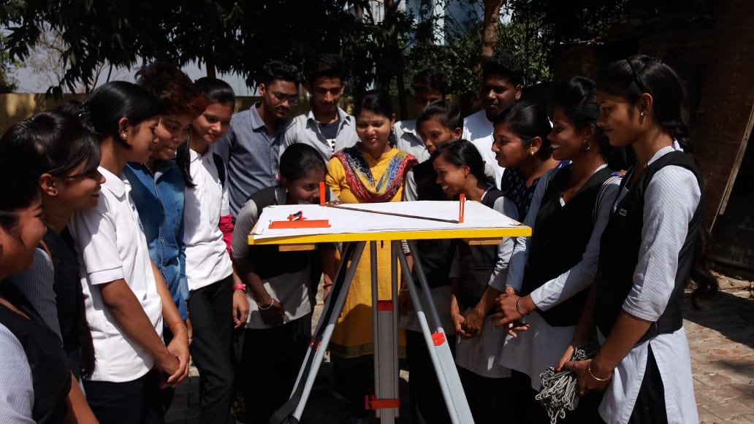
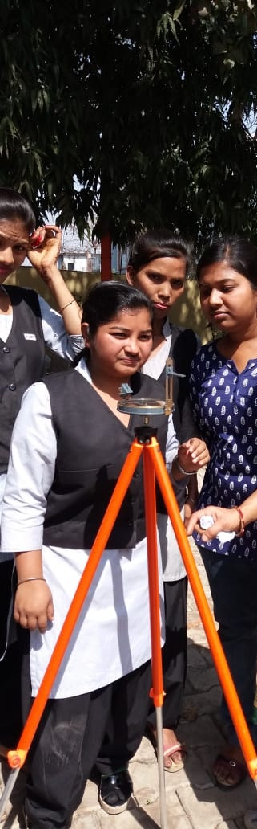
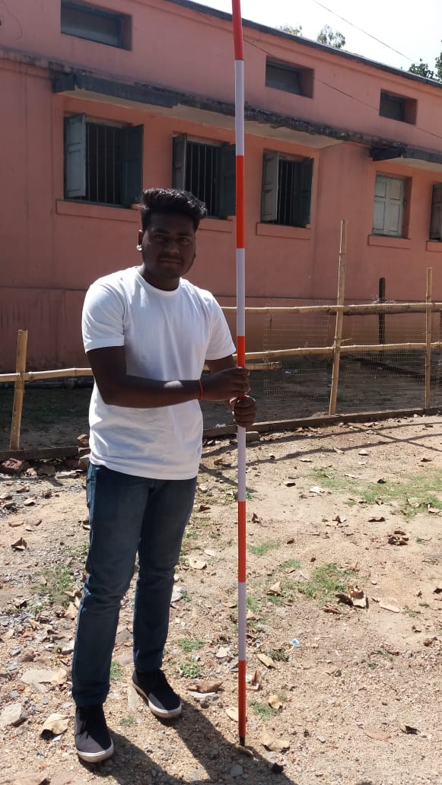
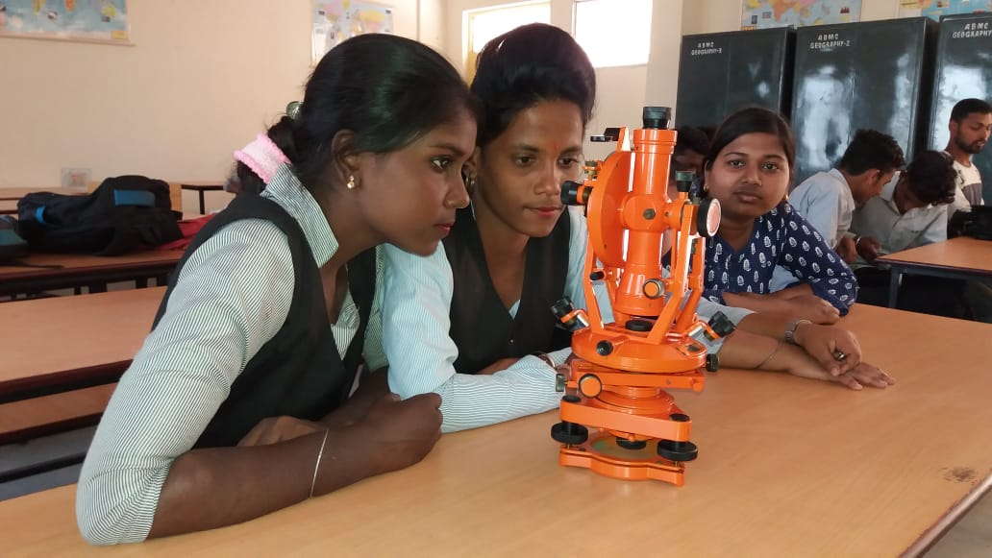
SURVEY CAMPS

Slide 14
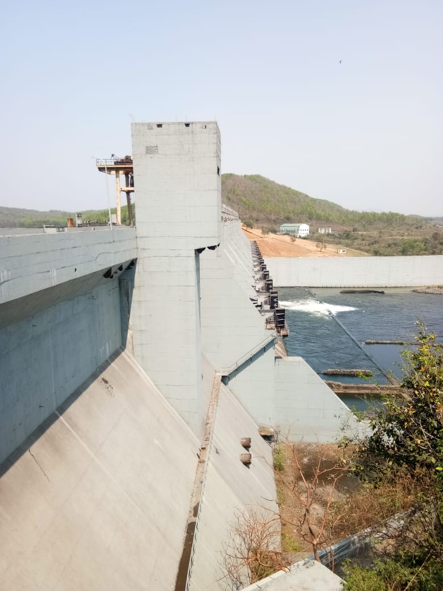
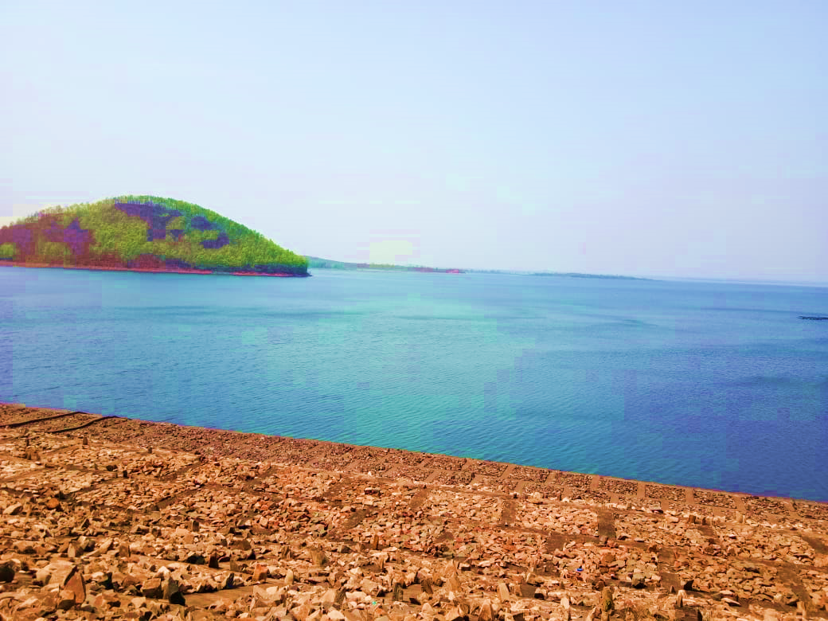
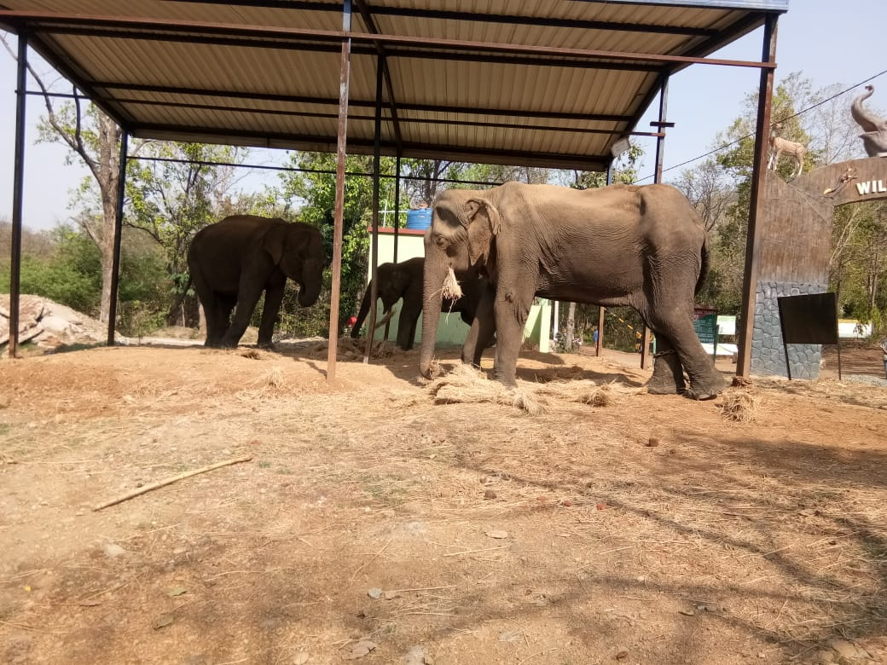
EDUCATIONAL TOUR

Slide 15
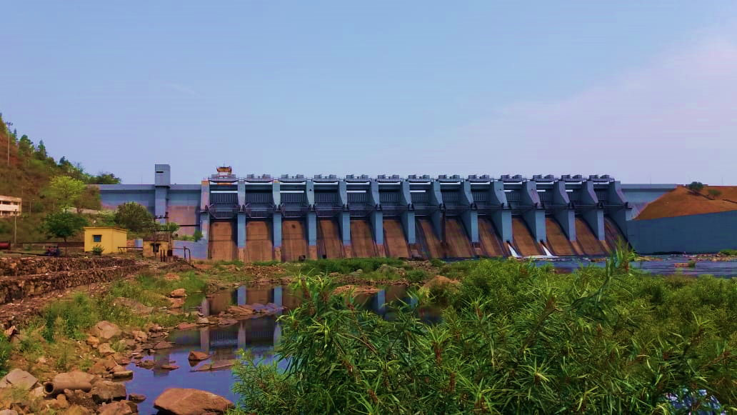
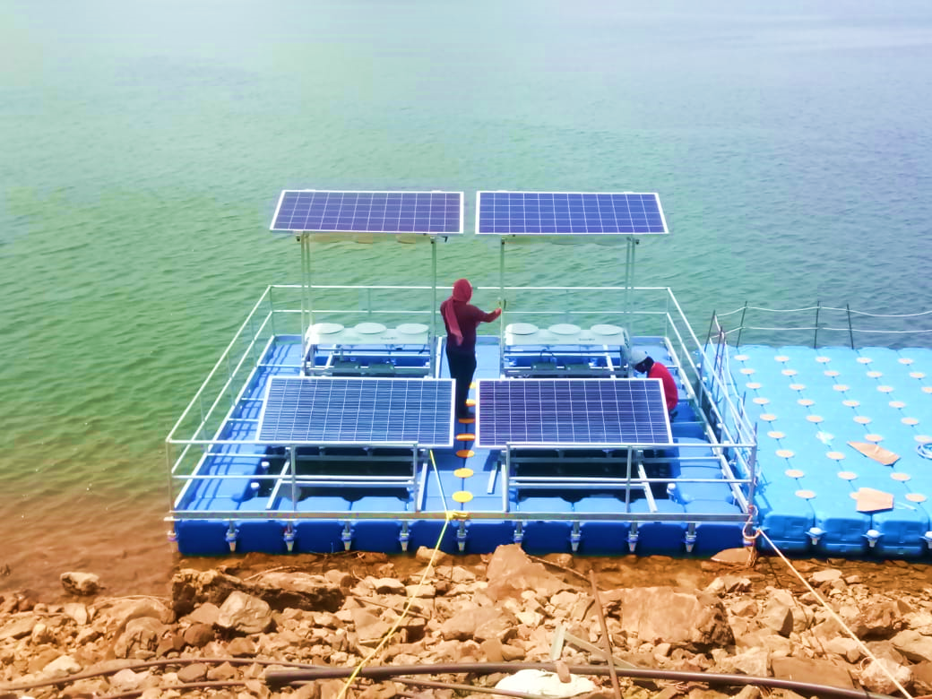
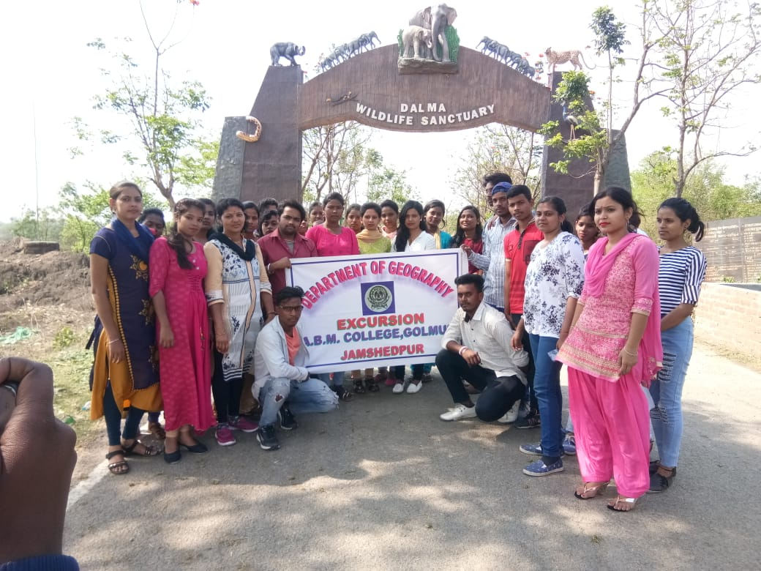
EDUCATIONAL TOUR

Slide 16
Strength :
Percentage of female students is more than male students.
Percentage of admission in Geography has increased in recent years.
Percentage of failure students has decreased in last few years.

Slide 17
Weakness :
Students from economically weaker families work part time jobs so they are unable to attend classes properly.
Female students are get married during their studies.

Slide 18

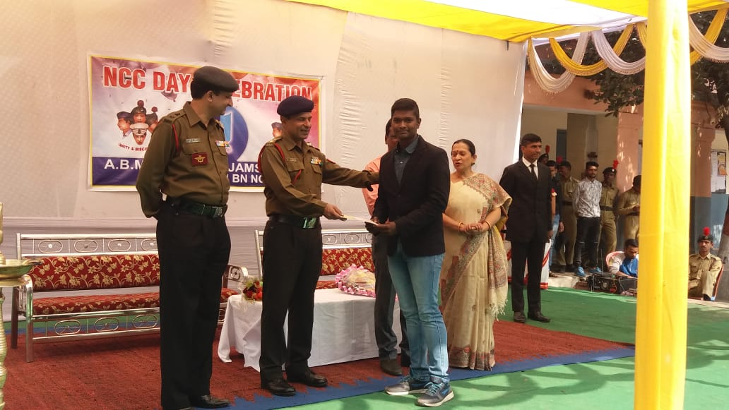
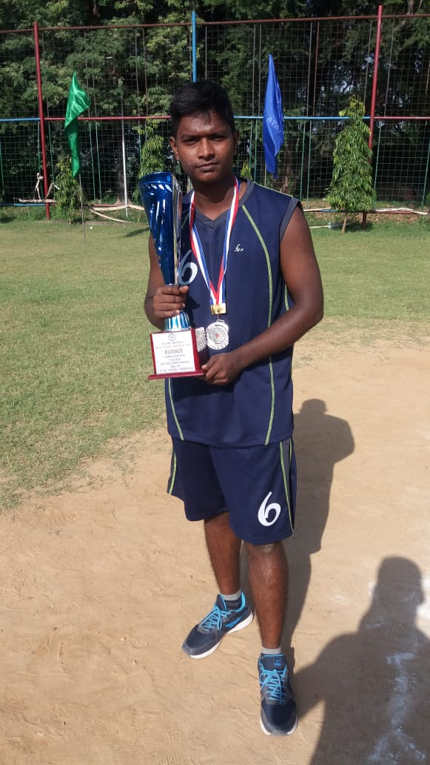
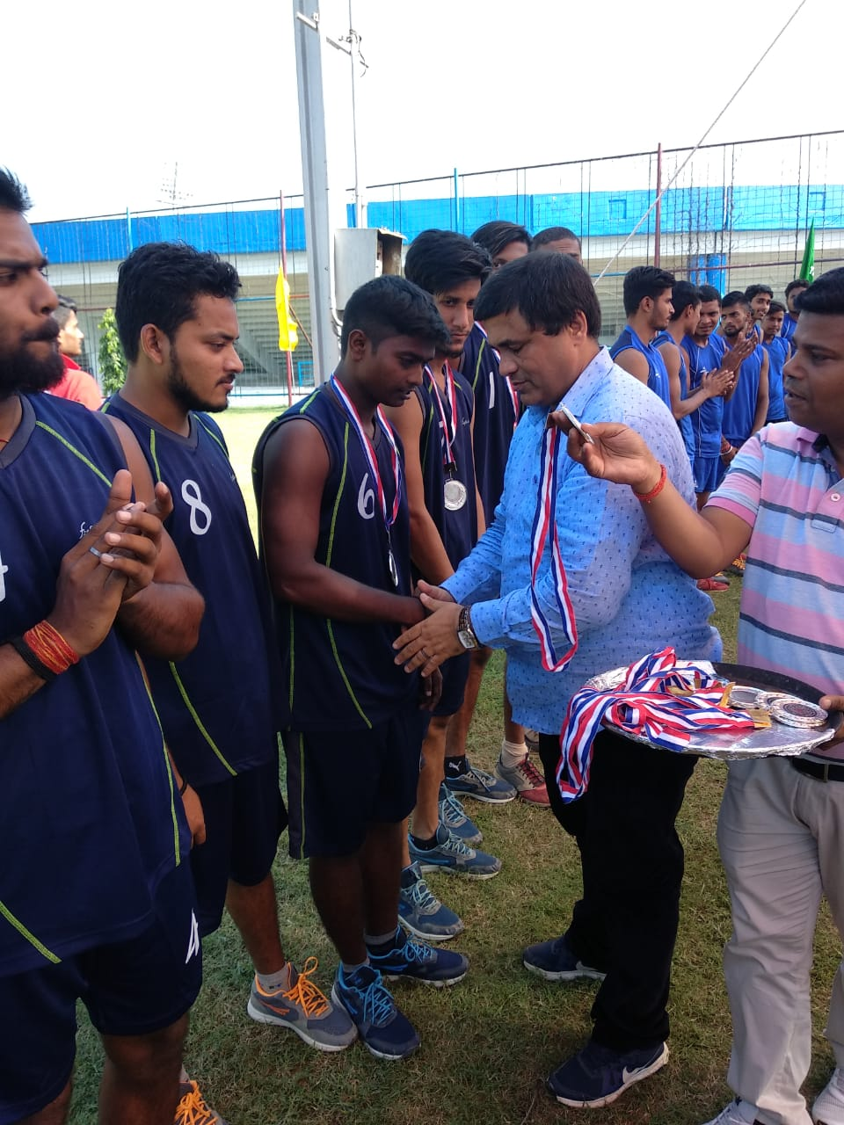
STUDENT’S ACHIEVEMENTS

Slide 19
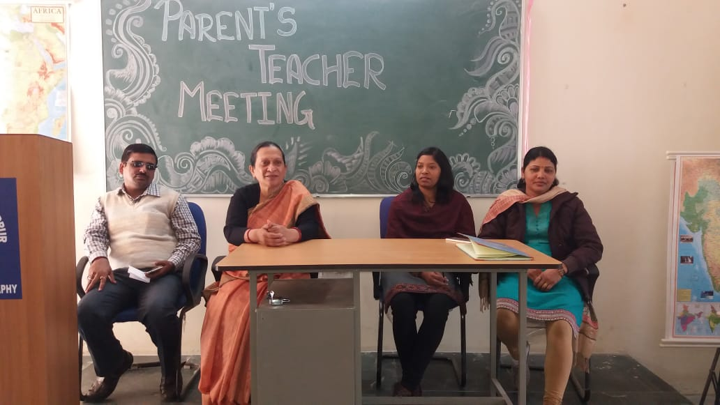
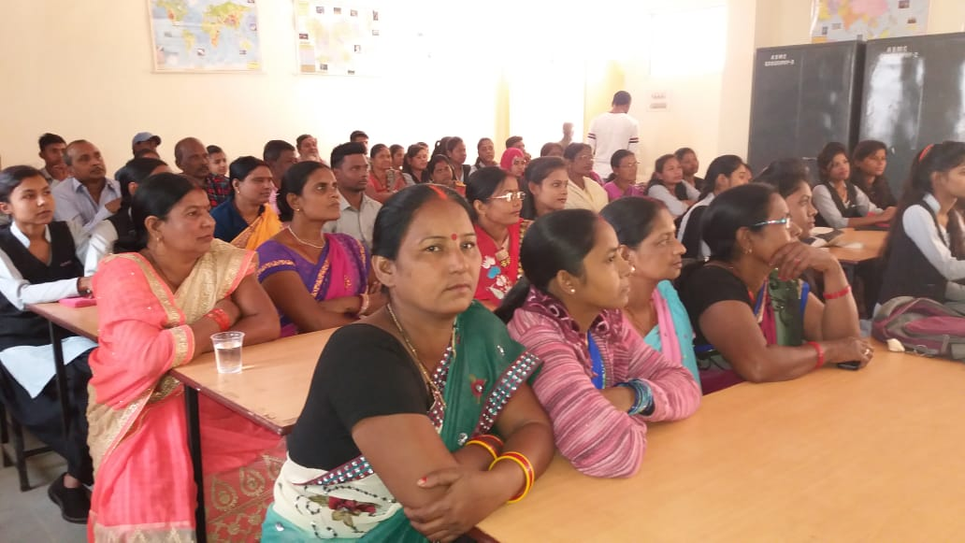
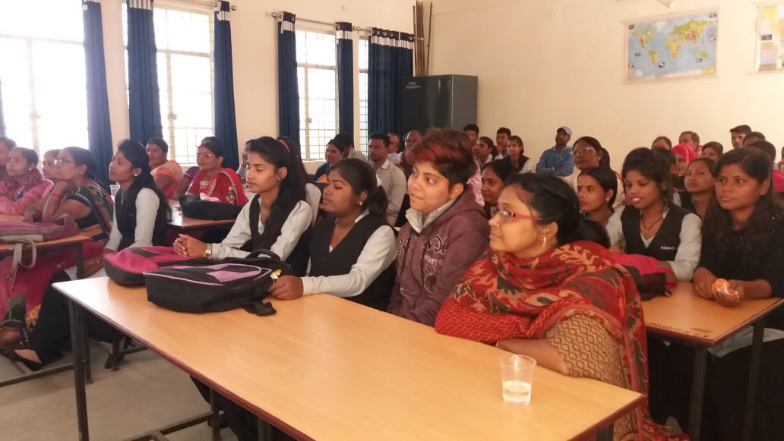
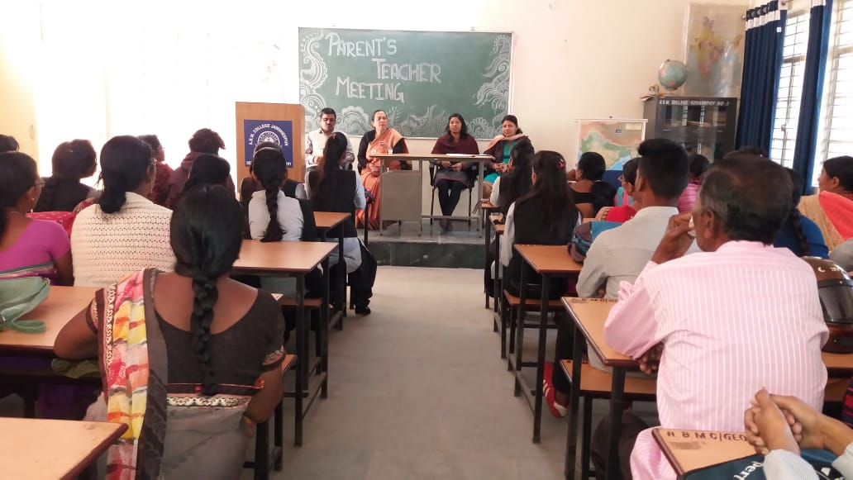
DEPARTMENTAL ACTIVITIES

Slide 20
Thank
You!!!

